Slide 1
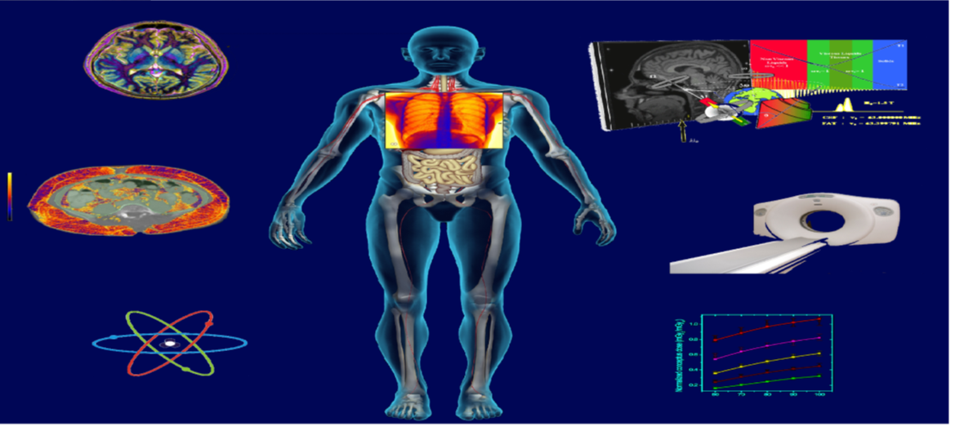
Medical physics (code)-year 1
By: Dr.Mohammed Ali Jaber
Physiology Department
College of Medicine
University of Basrah

Slide 2
Terminology ,Modeling, Measurement
Objectives:
At the end of the lecture the student will be learning
What the term medical physics refers to.
Concepts of physical modeling.
Physical measurements.

Slide 3
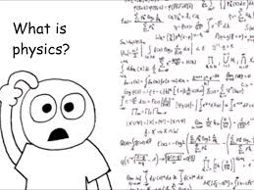
Terminology
Specialized words or meanings relating to a particular field,
Concepts of Medical Terminology

Slide 4
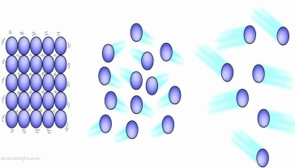
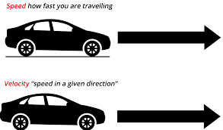
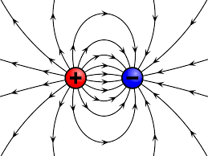
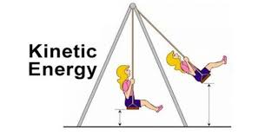
What is physics
Matter
Velocity,
Motion
Electric Field
Energy
Kinetic Energy
Force
Find relationships between those fundamental measured quantities (e.g., Newton’s Laws, conservation of energy)

Slide 5
Medical physics
Medical physics : The application of physics principles to medicine,
There are many branches of medical physics
Diagnostic radiology
Nuclear medicine
Radiation oncology ( radiation therapy )
Health physics ( Radiation protection )

Slide 6
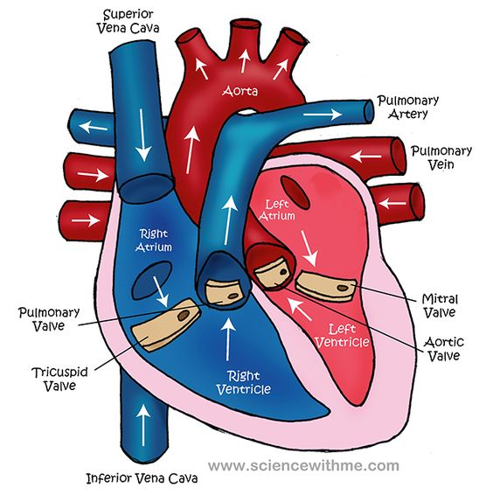
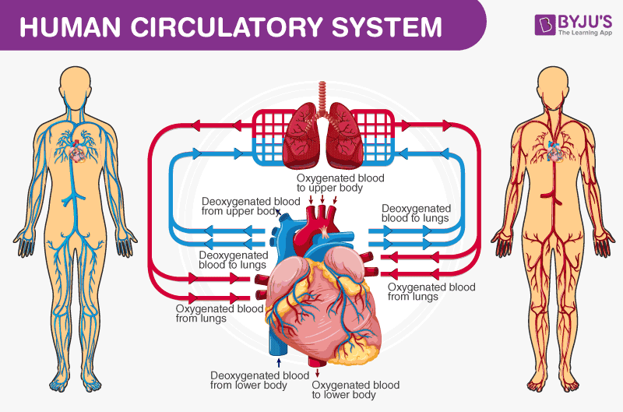
Physics can be found in various area of medicine ;
In Physiology

Slide 7
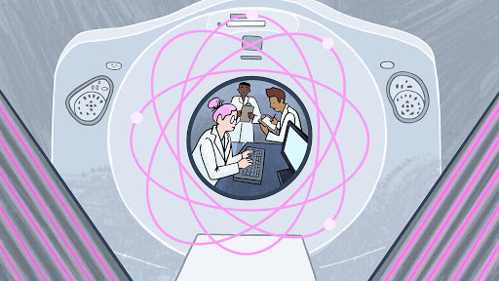
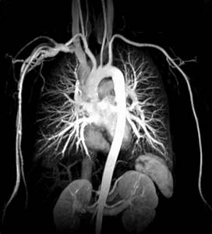
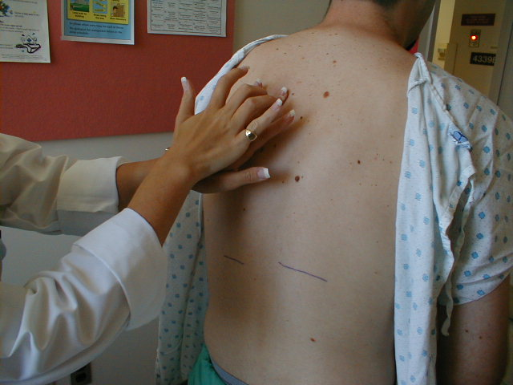
In practice of medicine :The application of physics to the practice of medicine
Diagnostic equipment includes medical imaging machines, used to aid in diagnosis :
Ultrasound , radiation, MRI machines, PET and CT scanners, and x-ray machines.
The tapping of the chest (percussion),
The physics of the stethoscope

Slide 8
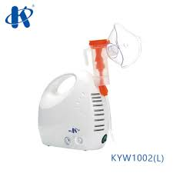
Treatment equipment , includes infusion pumps, medical lasers and laser vision correction
Life support equipment is used to maintain a patient's bodily function.
Biophysics : is the study of biological process using the theories and tools of physics .

Slide 9
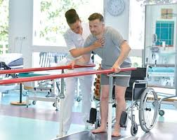
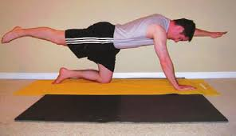
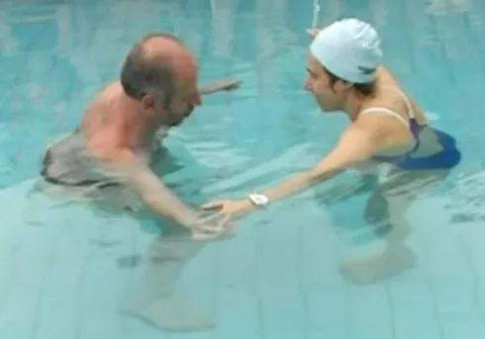
Physical Medicine and Rehabilitation
Enhance and restore functional ability and quality of life
Rehabilitation
exercise
water
Physical therapy

Slide 10
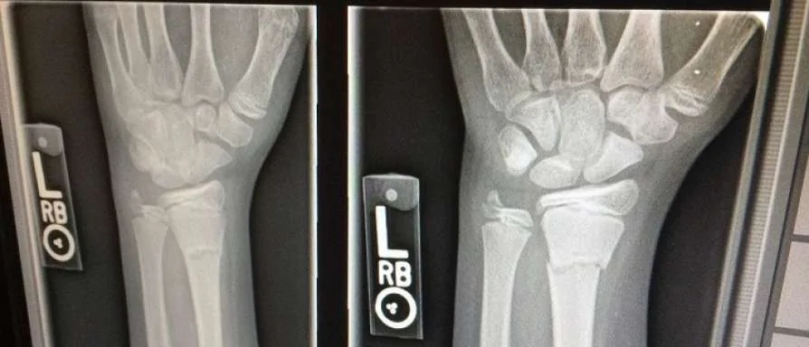
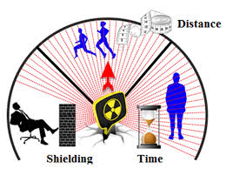
The field of medical physics has several subdivisions:
1. Radiological physics
2. Radiation protection (Health physics): ( of patients, workers, and the general public).

Slide 11
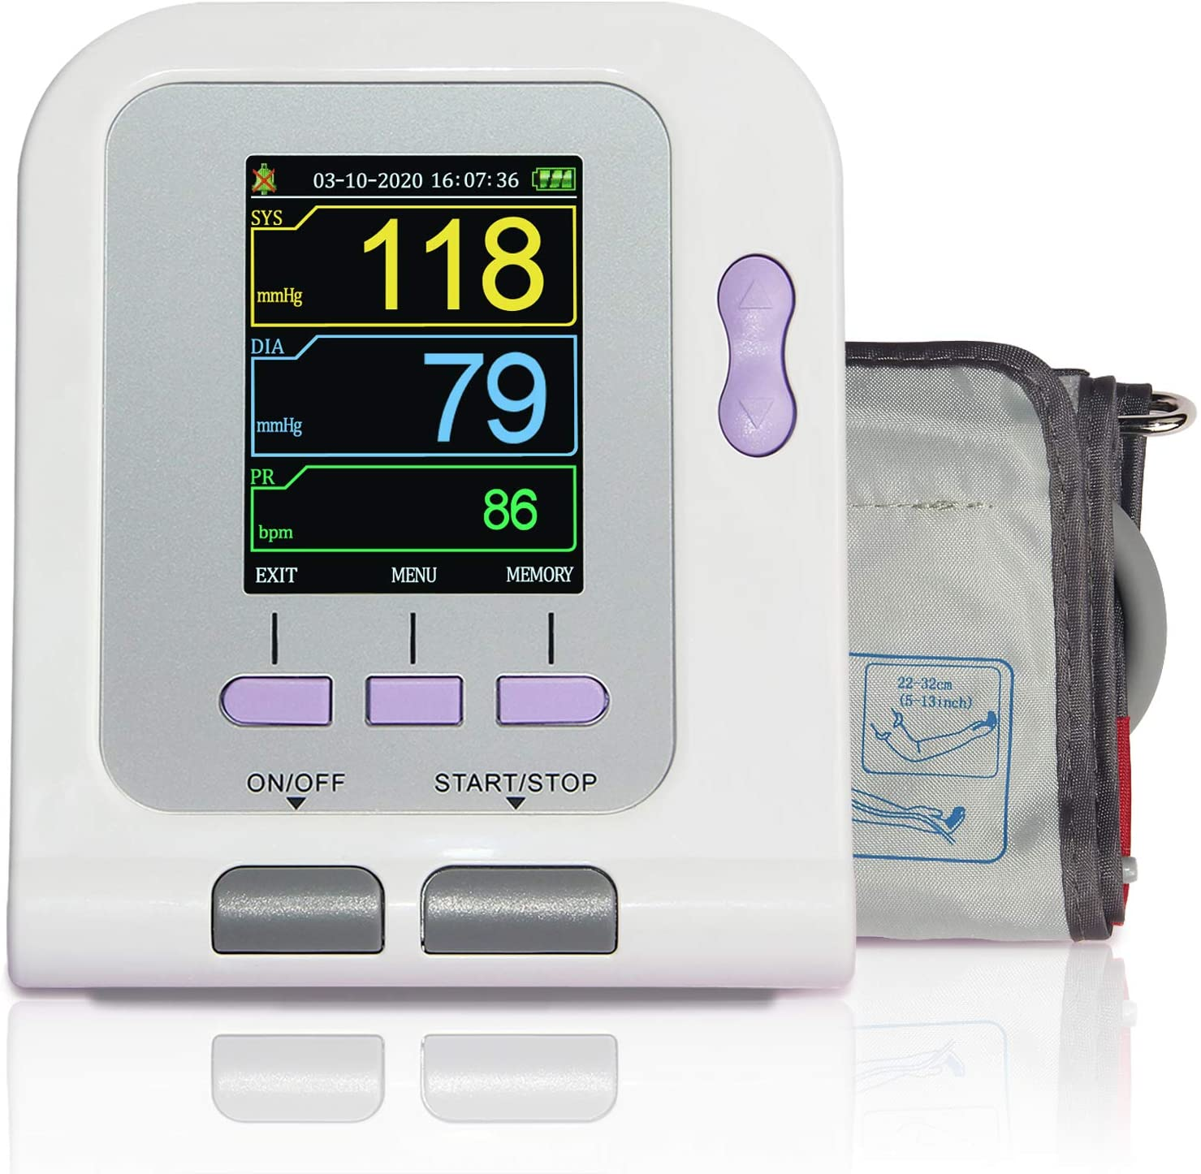
3. Medical physics could be called medical engineering.
or biomedical engineering is likely to be working on medical instrumentation, usually of an electronic nature
4. In some areas, such as the applications of ultrasound in medicine and the use of computers in medicine,
You are likely to find medical physicists and medical engineers in nearly equal numbers. ( medical = clinical i.e., clinical engineering or clinical physics).

Slide 12
Modeling
It's the process of representing phenomenon as set of mathematical equation, to study the effect of changes on it.
• To understand physical phenomena use ;
Simplification by selection of main features (Physical world )
o Analysis
o Qualitative or quantitative expression and verification

Slide 13
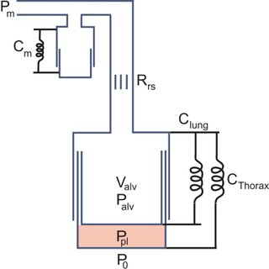
Analogies
Analogies is used to understand the physical aspects of the body.
To describe and explain phenomena that can't experience directly physicists employ models, using different types for different aims.
Mechanical model of lung and chest wall

Slide 14
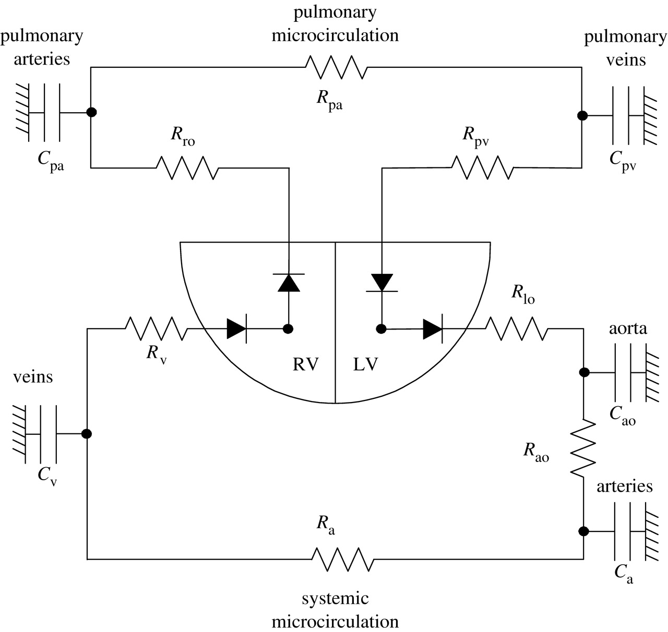
Analogies
Cardiovascular model as electrical circuit

Slide 15
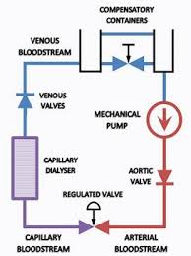
Mechanical model for the cardiovascular system

Slide 16
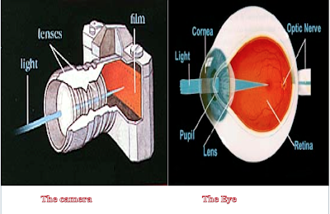
The eye is analogous to a camera

Slide 17
Mathematical modeling:
Consist of Equation and Function .
Equation such as
QA (t) =QA1 (t) + QM (t)
Where QA(t) flow through aortic valve
QA1(t) initial flow through aortic valve
QM(t) initial flow through pulmonary valve
Newton second law { F = ma }
Where : F : is the force
M : is the mass , a : is acceleration

Slide 18
Function model such as { R =f ( p) } to indicate the heart rate R is the function of the power produce by the body .
Feedback control (homeostasis): it is a control mechanism that uses information from measurement to manipulate a variable to achieve the desired result.
There are two type of feedback control
Negative feedback
- Positive feedback
• Negative feedback helps the system toward equilibrium state.
Example:
- Home thermostat
Regulation of blood sugar level,

Slide 19
Positive feedback is mechanisms enhance the original stimulus.
Example:
Blood clotting

Slide 20
Measurements
Measurements: is the numerical quantitation of the attributes of an object or event, which can be used to compare with other objects or events.

Slide 21
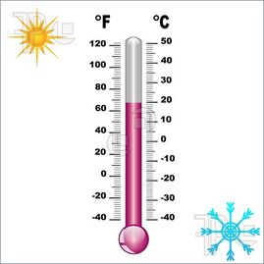
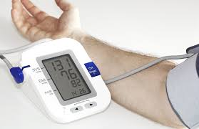
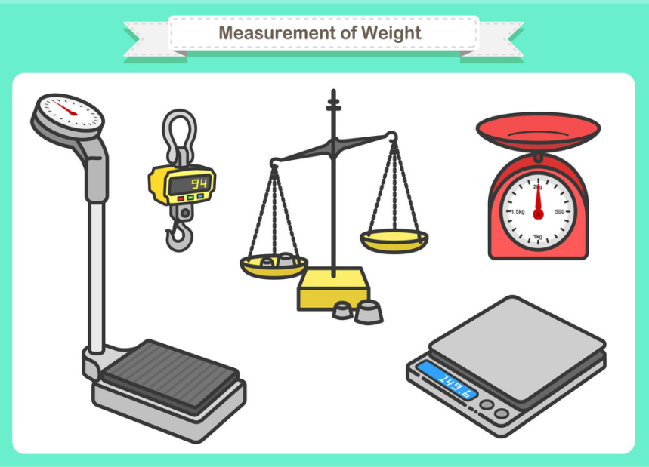
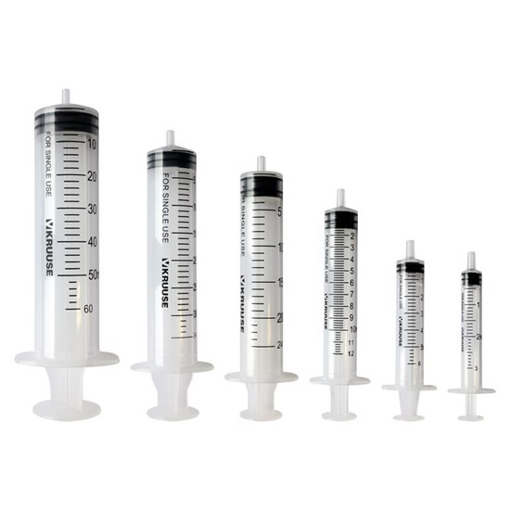
Practice medical measurements can be divided into: quantitative and qualitative measurements.
Quantitative measurement includes:

Slide 22
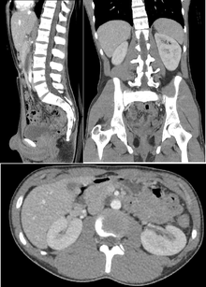
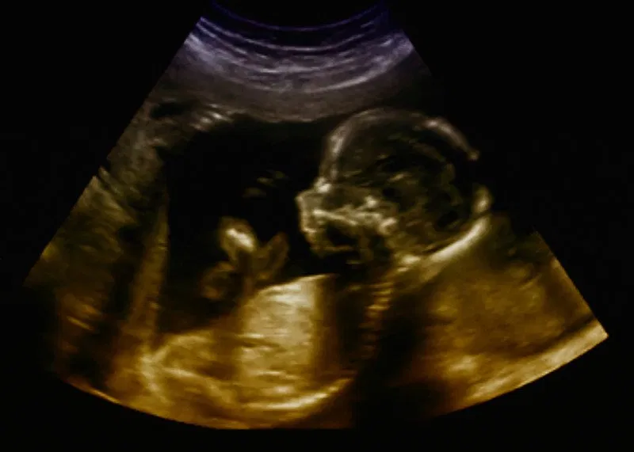
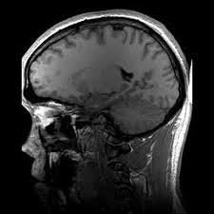
Qualitative measurement
Gives information about the inside of the body .
x-ray
( CT scan )
(US )
MRI

Slide 23
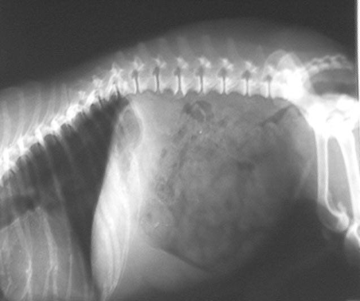
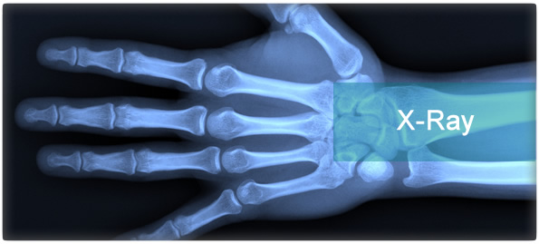
Ex .
gives
only qualitative information about the inside of the body
An X-ray
A repeat X-ray taken with a different machine may look quite different to the ordinary observer

Slide 24
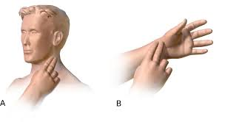
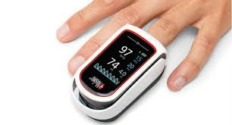
There are many other physical measurements involving the body and time. We can divide them into two groups: -
Measurements of repetitive processes, such as pulse. Involve the number of repetitions per second, minute, hour, and so forth.
For Example: -
The pulse rate is about 70/min.
The breathing rate is about 15/min.

Slide 25
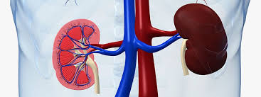
2. Measurements of nonrepetitive processes, such as how long it takes the kidneys to remove a foreign substance from the blood.
Nonrepetitive time processes in the body range from the action potential of a nerve cell (1msec) to the lifespan of an individual

Slide 26
Units
There are several system of units
- International system SI unit: it measures quantity such as length (meter),Mass (kilogram), time (second), current (ampere).
- Nonstandard unit: which is used in medicine such as blood pressure which is measured in millimeter of mercury (mmHg).

Slide 27
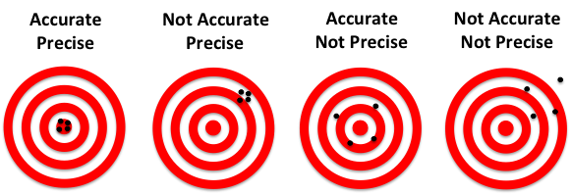
- Static characteristics that include accuracy and precision it is used in science and has different meanings.
Accuracy: refers to the degree of correctness of measurement when compared to true or absolute value.
Precision: refers to the degree of refinement of measurement.
After taking a lot of measurements , you notice that they are all close to each other this is precision , if they are degree with the true value this is accuracy .

Slide 28
Sources of error in medical measurements
Errors can be either random or systematic depending on how they affect the results.
Psychological effects(carelessness or limitations of human ability)
Human factors such as environmental, individual characteristic which influence behavior.
Procedural error occurs when different procedures are used to answer the same question
4. Instrumental error happens when the instruments being used are inaccurate,

Slide 29
Errors or uncertainties from measurements can be reduced by: -
1. Being Careful in taking the measurement.
2. Repeating measurements.
3. Using reliable instruments.
4. Properly calibrating the instruments.

Slide 30
References:
Medical physics / John R. Cameron & James G. Skofronick /1978.
Physics of the Human Body/Dr. Irving P. Herman/ 2007.
Medical physics and biomedical engineering/B H Brown, R H Smallwood/ 1999.

